Slide 1
Open Data Initiative:
WHAT’S IN IT FOR LIBRARIES?

Slide 2
Who and Why
Who are we?
Who are you?
Why are we here?
Notes:
Who are we? Intros – Rand and Will
Who are you? (Will) Librarians/non-librarians; public libraries/academic libraries/ school libraries/other; information providers;
Why are we here? Why did you choose this session? Rand: Reason for proposing this session; Will: Reason for delivering content

Slide 3
What is Open Data?
Open Data
Open Data means public data that are
freely available,
machine readable, and
structured in a way that enables the data to be
fully discoverable and
usable by end users
Structured Data
Public Data
All Data
Notes:
Washington State Open Data Initiative
https://ocio.wa.gov/initiatives/open-data
Open Data is
public information – can be or currently is released to the public
most valuable when it is used - by citizens, civic groups or private companies
needs to be accessible, accurate and authoritative
should be easy to post but curated for quality - including regular updating and timeliness; easy to find and hard to break; offered voluntarily to support jobs, justice and civic action.

Slide 4
What's the Initiative?
Publishing data: 1000+ datasets
Planning for more: state IT policy
Surveying with partners
Results Washington
Open Data Policy
Open Data Impact Survey
Will

Slide 5
Toys for Tots
https://fortress.wa.gov/ecy/cspareporting/Default.aspx
Department of Ecology tests consumer products for potentially dangerous chemicals. The lab is just behind the agency’s library, BTW.
Here’s what they have found in kids’ tabletop toys and games in the past year.
Good info, but you’d need help navigating it

Slide 6
Waiter there’s a fly in my soup
https://data.kingcounty.gov/dataset/Inspections2014/a6y8-bqss
Going to dinner in Seattle? King county publishes the results of health inspections.
Yellow means unsatisfactory.

Slide 7
Same fly, different city
https://www.yelp.com/inspections/balompie-cafe-san-francisco
In San Francisco, Yelp has taken this kind of data one step further and made it more readable.
In WA the same data is available, but you might need a librarian to find and understand it…

Slide 8
Everybody’s Favorite
Cannabis
https://insight.livestories.com/s/recreational-marijuana-revenues-in-washington-state/5588e0e8a750b313834c5582/
This was a student project for DOR, showing the tax revenue impact and sales in the first year

Slide 9
Crime maps
http://spokane.maps.arcgis.com/apps/webappviewer/index.html?id=3ad764a4c721463a88e7e3132b61eb69
Most big cities have a crime map. Here’s Spokane’s version (one of the best).

Slide 10
Crime Stats
http://wa-state-ofm.us/CrimeStatsOnline/
But even if your town can’t post a live crime map, you can still get open data about crimes in your county, from (of all places) the state Office of Financial Management.
Here’s a view of jail sentences for property crimes in Spokane County over 25 years…

Slide 11
Doc, are you licensed for this kinda thing?
https://data.wa.gov/Health/Health-Care-Provider-Credential-Data/qxh8-f4bd
The state department of health licenses all health care providers.
Hospitals, clinics etc. want to know whether their staff is current on their licenses before letting them on duty;
27,000 views this month

Slide 12
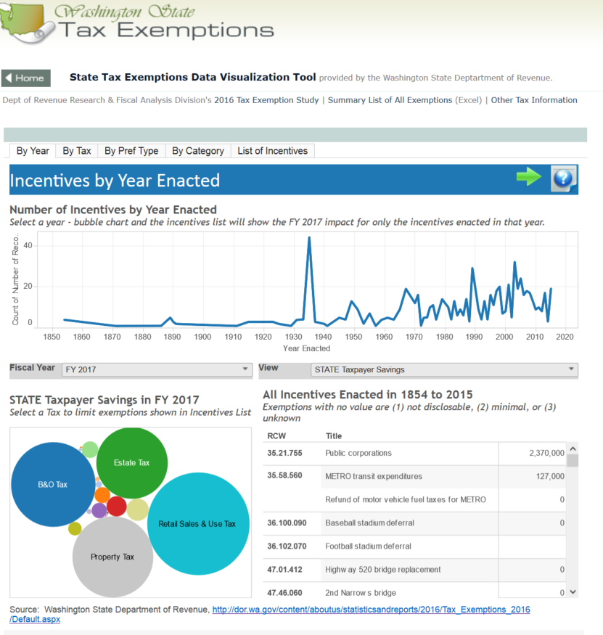
Taxes – or not
http://fiscal.wa.gov/TaxExemptions.aspx
Want to know when and why some companies pay less in taxes?
Look it up on fiscal.wa.gov, courtesy of the State Department of Revenue

Slide 13
What’s the role for Libraries / librarians?
Reference interview
Demographics of library users
Information professionals rooted in communities
Rand
Notes:
Gather ideas from audience
Potential reasons:
We are used to helping people locate information
Knowledgeable about how to use resources
Enthusiasm for helping people
Skilled in handling questions and instructional techniques
The reference interview: what does the customer actually want?
Knowledge of how to use application programs
Good communication skills – oral, written, telekinesis
People trust libraries and librarians
People perceive libraries as places to receive assistance and training
Librarians are Information professionals rooted in communities

Slide 14
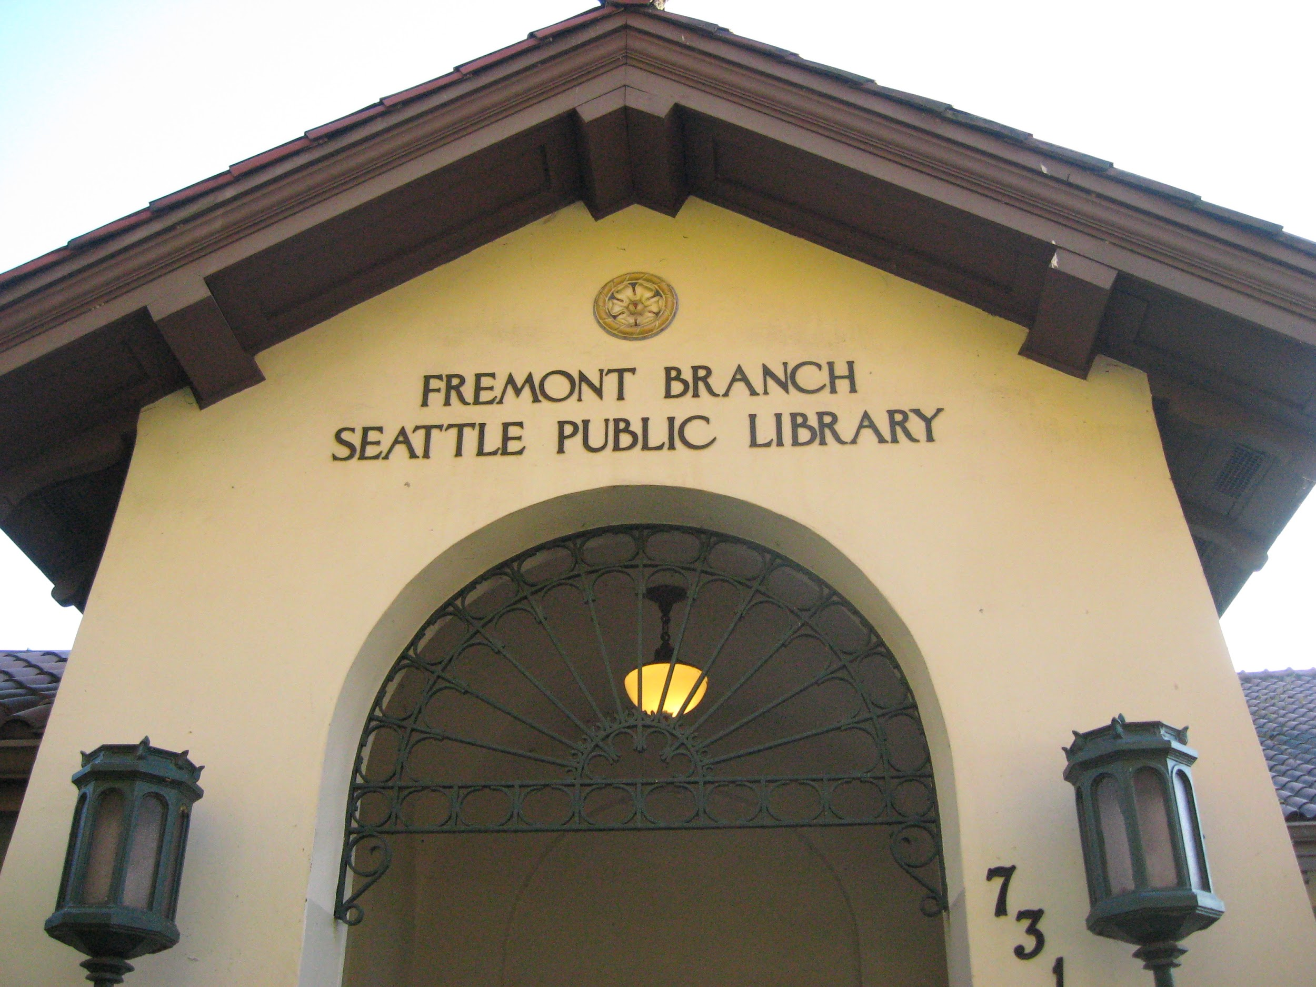
By empowering librarians with the knowledge to find and use this data, and creating tools for libraries to teach everyone in their community to find and use data, we will build a foundation for communities where everyone can open “open data”
78%
Rand
Notes:
Public librarians are the only group of information professionals really rooted in and serving the small and large communities across the country,
These are trusted institutions,
46 percent of Americans 16 and over have visited a library in the last twelve months.
78 percent of Americans think that libraries should definitely teach technology.
63% of people who have worked to solve a community problem use libraries.
59% of people who have tried to influence Government have used a library
(data from “Libraries at the Crossroads, Pew Research Center, http://www.pewinternet.org/2015/09/15/libraries-at-the-crossroads/ )
It makes sense to integrate open data training and knowledge in these important community institutions.
By empowering librarians with the knowledge to find and use this data,
and creating tools for libraries to teach everyone in their community to find and use data,
we will build a foundation for communities where everyone can open “open data”.

Slide 15
Is it Hard to Use or Learn?
data is available
you can access data
you can leverage data to create change
Will
Notes:
Lots of local, state and federal governments are releasing data in new ways.
They’re making it more open, accessible and reusable.
But they are sometimes challenged to connect with a community’s real needs and interests.
To make data helpful it needs to be not just available out there someplace
It has to be accessible;
most people need help to leverage data and create change

Slide 16
Announcing
Data Equity for Main Street:
Bringing Open Data Home
through local libraries
Will

Slide 17
What will it do?
Now
1) Librarians & Technologists Create Curricula
2) Grants to Train Librarians
3) Grants for Librarians to Train their Communities
About the Project:
Knight Foundation
Library Journal
Organizers / Team
Anne Neville (CA State Library)
Will Saunders (WA Tech Solutions)
Will
Notes:
What are we going to do are going to bring together librarians and civic technologists and create free and reusable curricula. We’ll use a train-the-trainer model so that librarians can find, evaluate and use open data. And, librarians will have new resources to train community members and organizations. We’re going to provide grants to libraries so that they can pilot these tools, and we’ll use feedback from these libraries to improve the data and make more valuable to all our communities.
Project Description
Together with a diverse team of public librarians and civic technologists across California and Washington, our project team will develop two Open Educational Resource (OER) modules:
Train-the-Trainer: A train-the-trainer approach for professional librarians will enable them to develop the skills they need to help patrons find and use relevant local, regional, state and national open data resources. This curriculum will also underscore the importance of providing feedback to government agencies that produce data in order to help improve the quality and relevance of data they release.
Class Training Materials: Libraries can add these hands-on open data lesson plans to existing digital and information literacy programs or offer them as stand-alone classes or workshops. These lessons will help members of the community and community organizations learn what open data is, how to find it, easy ways to use it, and why it is important to provide feedback to the governments and organizations that created the data.

Slide 18
Name | Organization
Ann Glusker | Seattle Public Library
Kate Laughlin | Primary Source
Misty Jones | San Diego Public LIbrary
Heidi Dolamore | San Jose Public Library
Tara Neumann | Spokane Public Library
Jenifer Ashby | Asotin County Library
Barbara Soots | WA OSPI
Debbie Faires | SJSU
Xavier Leonard | Civic Tech something
Merida Kipp | Yakama Nation Library
Marnie Webb | Caravan Studios
Librarians and Civic Technologists Create Curricula
Meet the
Curriculum Committee
Will

Slide 19
Wrap up
-
Handouts in the back
Data visualization tools
Map of major sites
- Data online – try it out
- Data Equity for Main St.
https://ocio.wa.gov/data-equity
- Hang out for demos
Rand
Notes:
Rand

Slide 20
Presented by
Rand Simmons, Federal Collections, Washington State Library http://sos.wa.gov/library, rand.simmons@sos.wa.gov
Will Saunders, Open Data Guy, Washington Technology Solutions (WaTech) https://ocio.wa.gov/initiatives/open-data, will.saunders@watech.wa.gov

